Slide 1
The Role of Disk Volatile Chemistry and Dynamics in Shaping the Compositions of Nascent Planets
Ana-Maria Piso
Advisor: Karin Öberg
Collaborators: Ruth Murray-Clay, Til Birnstiel, Ilse Cleeves, Jamila Pegues
Thesis Advisory Committee: Matthew Holman, Sean Andrews, Dimitar Sasselov
TAC Meeting Presentation: April 29th, 2015
Notes:
…and what I would like to talk about today is the minimum core mass for giant planet formation. Now, when we think of minimum core mass, we think core accretion. In core accretion, we know that for a giant planet to form it needs a solid core, that grows, and once it becomes massive enough it can then accumulate a significant atmosphere. How big of a core do we need? Well, typically this value is believed to be around 10 Me. However, this is not a constant, and it not only depends on where we are in the disk but also on how fast the core grows. Now why do we care about this? We have seen throughout this week giant planets imaged at wide separations. Now, we don’t know whether these planets formed through core accretion or not; but if they do, and if core accretion works at large separations, then it’s very important to understand how it works, and more importantly to be able to place a robust absolut minimum for a giant planet to form within the lifetime of the protoplanetary disk. And this is what I am going to talk about today.

Slide 2
Outline
Brief Background Info
Research Accomplished Since Last Meeting
Further Preliminary Results and Next Steps
Proposed Completion Timeline

Slide 3
Outline
Brief Background Info
Research Accomplished Since Last Meeting
Further Preliminary Results and Next Steps
Proposed Completion Timeline

Slide 4
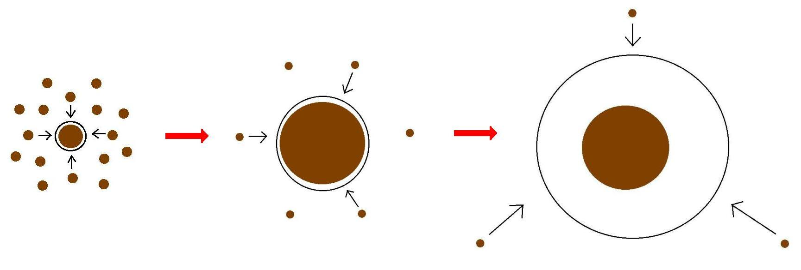
Core Accretion Model
The composition of planets is determined by and tightly linked to the disk composition

Slide 5
BASIC IDEA
Understand the disk well enough to:
Predict what kind of planet compositions result from planet formation in different parts of the disk
Back-track the planet formation location based on the planet composition

Slide 6
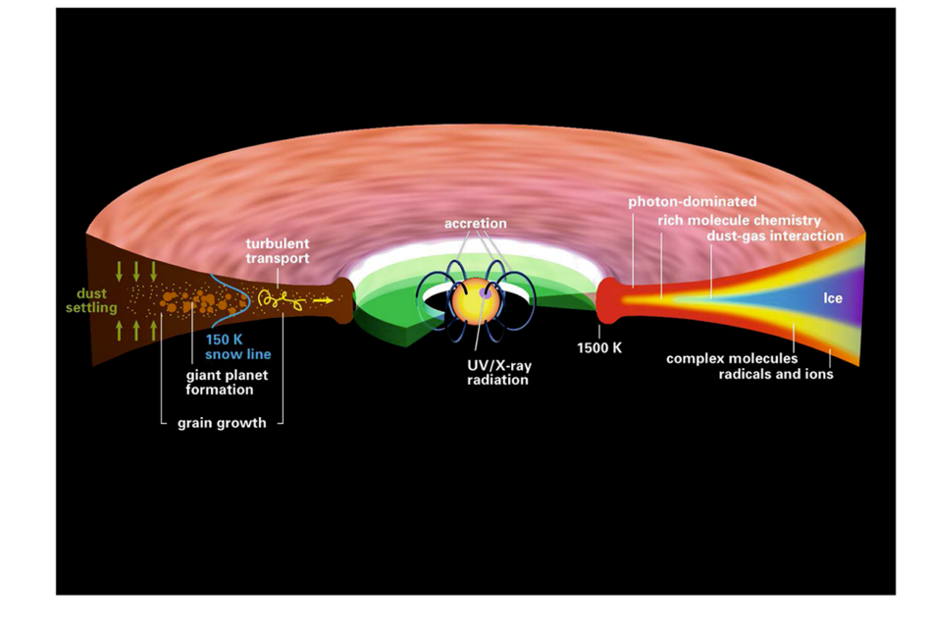
Disk structure is complex!
Henning&Semenov (2013)

Slide 7
GOAL
Explore and understand the dynamical and chemical processes occurring in disks, and their relative importance in shaping disk compositions throughout time

Slide 8
Outline
Brief Background Info
Research Accomplished Since Last Meeting
Further Preliminary Results and Next Steps
Proposed Completion Timeline

Slide 9
Understand how radial drift and gas accretion affect snowline locations, and thus the C/O ratio in gas and dust throughout the disk
GOAL

Slide 10
Observations show that C/O ratios in giant planet atmospheres are different from stellar
After Oberg+11

Slide 11
Timescales for desorption, radial drift and gas accretion ARE comparable
Piso+15

Slide 12
Radial drift affects snowline location
Piso+15

Slide 13
We determined upper limits for the C/O ratio across the disk
Piso+15

Slide 14
The desorption distance is independent of disk mass
Piso+15

Slide 15
The desorption distance for transition disks agrees with observations
Piso+15

Slide 16
Paper submitted to ApJ on August 14th
Piso, A.-M. A., Oberg, K. I., Birnstiel, T., & Murray-Clay, R. A.
C/O and Snowline Locations
in Protoplanetary Disks: The Effect of Radial Drift and Viscous Gas Accretion.
ApJ, under review

Slide 17
Outline
Brief Background Info
Research Accomplished Since Last Meeting
Further Preliminary Results and Next Steps
Proposed Completion Timeline

Slide 18
GOAL
Add nitrogen and hydrocarbons in the chemical and dynamical framework and explore their effects on the C/O/N ratio
Can use abundance patterns both from the Solar System and from disk chemistry models (e.g., Schwarz & Bergin 2014) to define the range of abundance of different nitrogen carriers

Slide 19
Expected abundances of CH4 do not change C/O results significantly

Slide 20
Expected abundances of NH3 do not change N/O results significantly

Slide 21
Results for the N/C ratio in a static disk

Slide 22
Next Steps
Calculate the C/N/O ratios in active disks, for different ice compositions and morphologies
Use different abundances for the main nitrogen and carbon carriers
Use new results for the binding energies for N2 and CO, both mixed with water and as pure ices
Calculate the C/N/O ratios self-consistently
Basic idea: treat each species in gaseous and solid form as two fluids that are interchanging and use advection-like equations to solve for their separate time-dependent abundance
Consider ice species composed of more than one single volatile
Incorporate chemical evolution in radial drift model

Slide 23
Outline
Brief Background Info
Research Accomplished Since Last Meeting
Further Preliminary Results and Next Steps
Proposed Completion Timeline

Slide 24
Thesis Timeline
Paper I: “C/O IN PROTOPLANETARY DISKS: THE EFFECT OF RADIAL DRIFT AND VISCOUS ACCRETION”. Submitted to ApJ
Paper II: THE ROLE OF ICE COMPOSITIONS AND MORPHOLOGY FOR
SNOWLINES AND THE C/N/O RATIOS IN ACTIVE DISKS”. Estimated first draft to be completed by September 7th. Estimated submission after receiving referee report on Paper I
Paper III: Self-consistent calculation of C/N/O ratios and considering particles composed of more than one volatile species. Estimated completion winter 2015
Paper IV: Chemical evolution incorporated in radial drift model. Estimated completion spring 2016
Overall goal: complete thesis and graduate in spring 2016

Slide 25
Postdoc Applications Details
Plan to have a preliminary version of my research proposal with a week
Will apply for the prize fellowships (Pappalardo, Miller, Sagan, Hubble), as well as regular postdocs at MIT and possibly Berkeley

Slide 27
Radial drift of solids
Gas moves at sub-Keplerian velocity:
v_{gas} ~ v_{K} (1-c_{s}² / v_{k}²)
Small particles (~micron size) move with the gas
Large particles (~km size) are unaffected by gas drag
“Intermediate sized” particles (~cm-m size) experience a headwind and drift towards the star

Slide 28
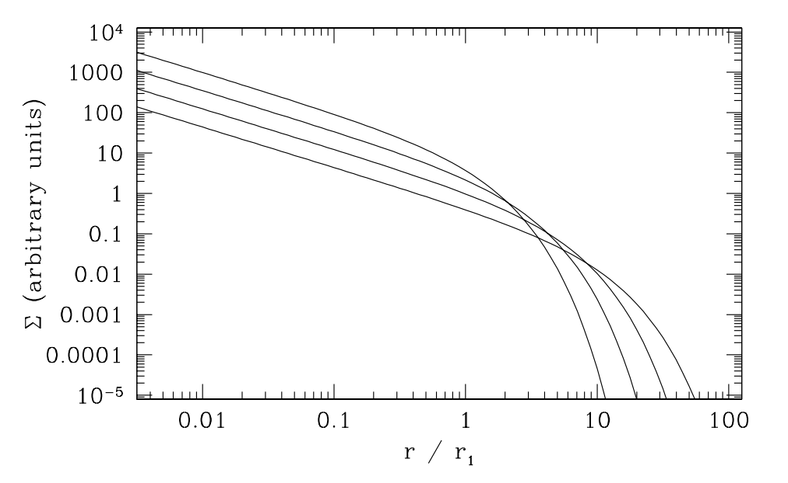
Gas disk accretes onto the central star
alpha-disk prescription: ν = α c_{s} H
Armitage 2009

Slide 29
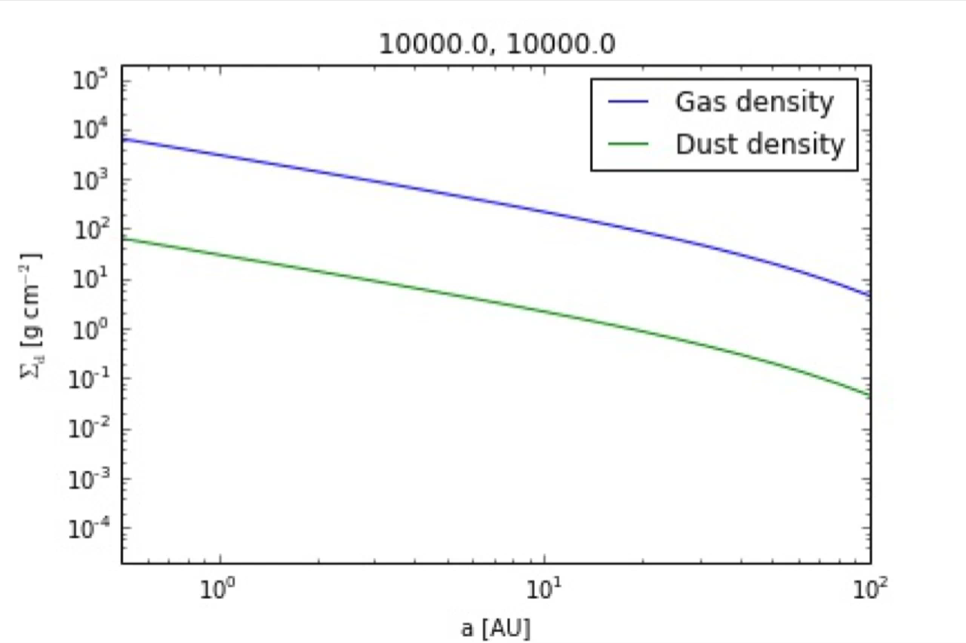
Determined profiles for gas and dust surface densities
s = 0.001 cm
alpha = 0.01, s = 0.001 cm

Slide 30

Determined profiles for gas and dust surface densities
s = 0.001 cm
alpha = 0.01, s = 1 km

Slide 31

Determined profiles for gas and dust surface densities
s = 0.001 cm
alpha = 0.01, s = 1 km
alpha = 0.01, s = 1 m

